Slide 1
The Price Ain’t Right? Hospital Prices and Health Spending on the Privately Insured*
Zack Cooper, Yale University
Stuart Craig, University of Pennsylvania
Martin Gaynor, Carnegie Mellon
John Van Reenen, London School of Economics
December 2015
www.healthcarepricingproject.org
*This research received financial support from the Commonwealth Fund, the National Institute for Health Care Management, and the Economic and Social Science Research Council.

Slide 2
Introduction
The US spends more than other nations on health care—$2.8 trillion dollars (17.2% of GDP)—without evidence of better outcomes
Wide ranging analysis of variation in health care spending via Medicare suggests quantity of care given drives spending variation [Dartmouth Atlas work: i.e. Fisher et al., 2009; Wennberg et al., 2002]
However, results may not generalize to private markets where prices are not set administratively [Philipson et al. 2010;Chernew et al., 2010; IOM, 2013; Franzini et al. 2010]
However, almost no nation-wide hospital-specific price data and scant data on spending for privately insured
© Cooper, Craig, Gaynor, and Van Reenen

Slide 3
This Paper
Analyzes employer sponsored insurance claims from Aetna, UnitedHealth, and Humana that includes negotiated transaction prices
Studies the variation in private health care spending, analyze the contribution of prices to spending variation, and examine providers’ price variation
Key Findings – Price Plays Crucial Role in Spending by Privately Insured
        Low correlation (0.140) between Medicare and private spending per person;
        Price explains large portion of national variation in inpatient private spending;
        Substantial variation in prices, both within and across markets;
        Higher hospital market concentration is associated with higher hospital prices;
© Cooper, Craig, Gaynor, and Van Reenen

Slide 4
Outline
Overview of the HCCI Data and Price Calculations
Public/Private Spending and Price/Volume Decomposition;
Variation in Hospital Prices Across Markets;
Variation in Hospital Prices Within Markets;
Predictors of Provider Prices;
Implications
© Cooper, Craig, Gaynor, and Van Reenen

Slide 5
The Data and Our Price Measures
© Cooper, Craig, Gaynor, and Van Reenen

Slide 6
Overview of the HCCI Data
Claims level data from the Health Care Cost Institute
Includes ESI claims from Aetna, UnitedHealth Group, and Humana for individuals with coverage from from 2007 – 2011;
          88.7 million unique individuals;
          Covers approximately 27.6% of Americans with ESI
Data includes the price providers charged, the negotiated contribution of the payers, and the contribution of patients via co-payments and co-insurance;
Able to link to a wide array of external data
© Cooper, Craig, Gaynor, and Van Reenen

Slide 7
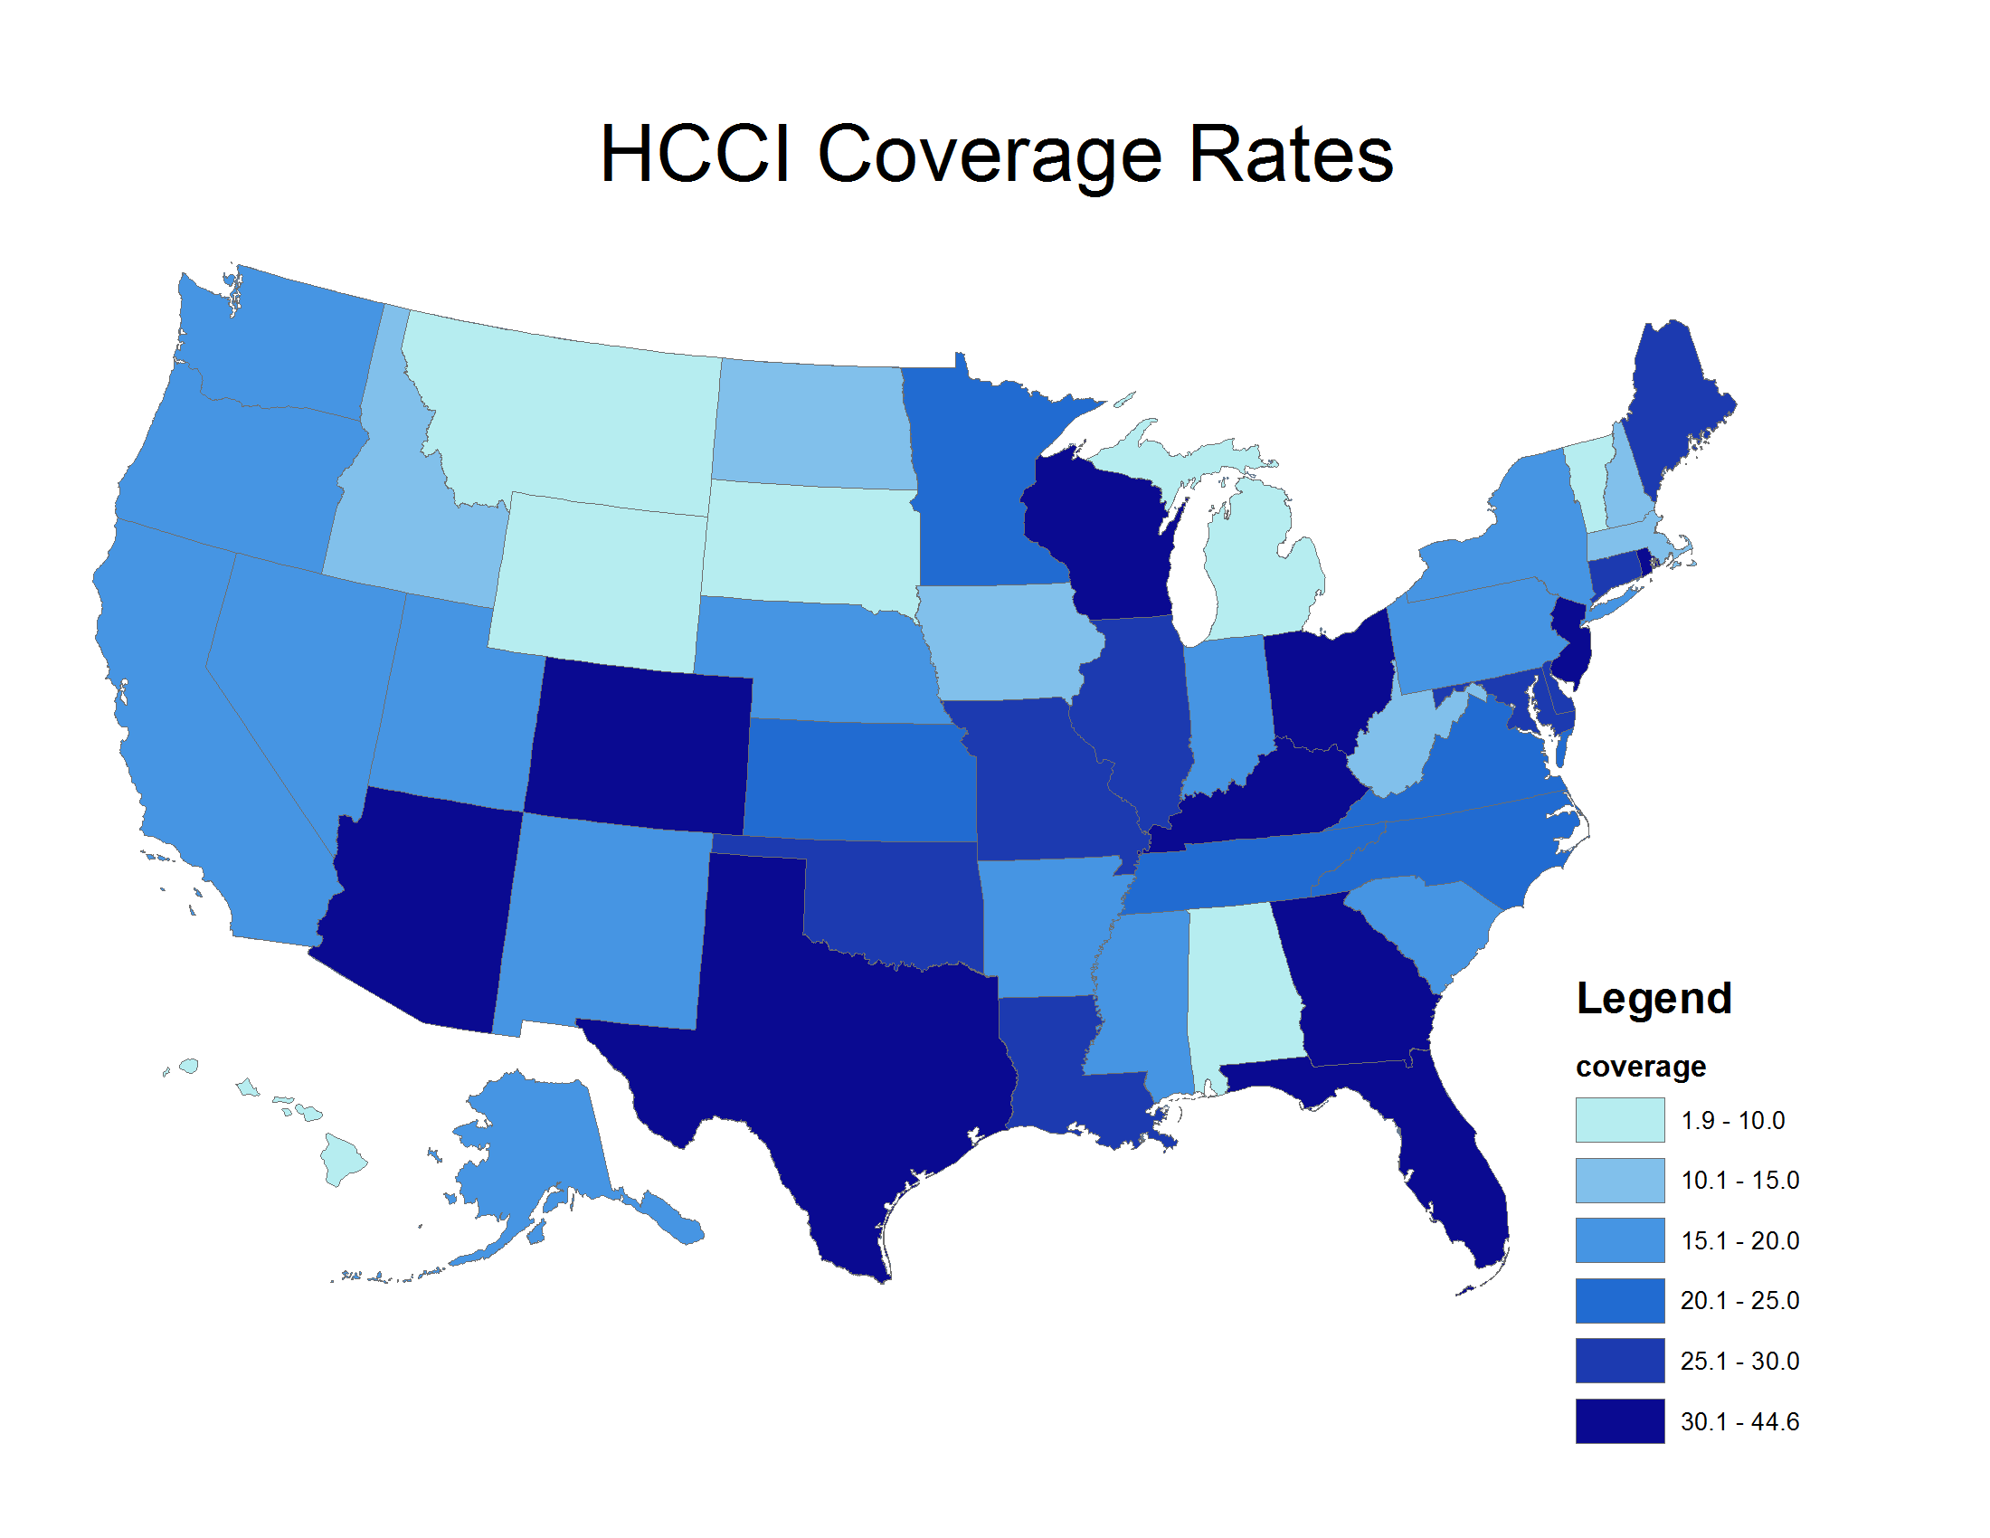
National Coverage of Data
High Shares: Texas, Arizona, Colorado, Florida, Georgia, Kentucky, Ohio, Wisconsin, New Jersey, DC, and Rhode Island have a high share of HCCI data.
Low Shares: Vermont, Michigan, Alabama, Wyoming, Montana, South Dakota, and Hawaii
VT
6.6
NH
13.7
WA
16.4
MT
8.8
ND
12.9
ME
25.4
MA
12.7
OR
16.0
MN
22.7
RI
31.0
ID
13.3
S.D.
7.8
WI
34.5
NY
19.0
WY
9.4
MI
9.9
IA
14.9
PA
20.0
CT
28.0
NV
13.7
NE
20.0
IN
18.0
OH
34.3
CA
15.6
UT
19.1
IL
26.8
NJ
39.2
CO
33.6
KS
21.7
MO
30.0
WV
11.5
VA
23.8
KY
44.2
TN.
22.0
NC
20.2
DE
29.2
AZ
39.8
NM
16.7
OK
26.3
AR
16.6
SC
15.8
MD
28.8
MS
15.9
AL
8.4
GA
44.6
DC
37.2
TX
42.9
LA
27.9
HI.
1.9
AK
15.2
FL
39.8
HI
1.9
Note: Coverage rates were calculated using HCCI enrollment data. Statewide insurance coverage totals were derived from the American Community Survey for 2011.
© Cooper, Craig, Gaynor, and Van Reenen

Slide 8
HCCI Data Overview
Approximately 1% of GDP;
Approximately 5% of health care spending;
Average HRR contains 116,231 members
Smallest HRR contains 3,492 members; largest HRR contains 1,439,182 members
Note: Prices are in 2011 dollars
© Cooper, Craig, Gaynor, and Van Reenen

Slide 9
Data Sample
Limit to those age 18-64 with ESI coverage and at least 6 months of coverage;
Three Samples
          Spending Sample: All physician, outpatient, and inpatient claims (no Rx)
          Inpatient Sample: All inpatient facilities claims
          Procedure Samples: Hip and knee replacements, vaginal and cesarean delivery, PTCA, colonoscopy, and lower limb MRI;
Limit observations to those with 1st percentile < price <99th percentile; exclude those with length of stay in top 1% by DRG/Condition, require match to AHA;
Limit to providers doing 50 episodes per year for inpatient analysis per year; 10 conditions for conditions per year.
© Cooper, Craig, Gaynor, and Van Reenen

Slide 10
Definition of Price
Price captures the amount a facility was paid (including by insurer and patient);
Identify risk-adjusted hospital prices for seven procedures identified using very narrow coding (i.e. no complications, no revisions), exclude LOS in top 1%, single ICD-9CM/DRG combo, ICD-9 Diag. code for colonoscopy; CPT-4 code for MRI*;
Create a hospital inpatient price index that is conditional on who a hospital treats and what mix of DRGs it delivers;
* For Medicare comparisons we use DRGs to define cohorts
© Cooper, Craig, Gaynor, and Van Reenen

Slide 11
How Medicare Sets Prices
Geographic Adjustment Factors
Capital GAF Adjustment
Capital Component
Operating base payment rate
Adjustment for Geographic Hospital Wage Index
Base Rate Adjusted for Geographic Factors
=
+
Operating Amount
Geo-specific Non-Labor Related Costs of Base Case
Hospital Adjusters
Indirect Medical Education Payment
Disprop. Share (DSH) Payment
Adjusted Payment Rate
MS-DRG Weight
Payment for MS-DRG
+
=
x
=
© Cooper, Craig, Gaynor, and Van Reenen

Slide 12
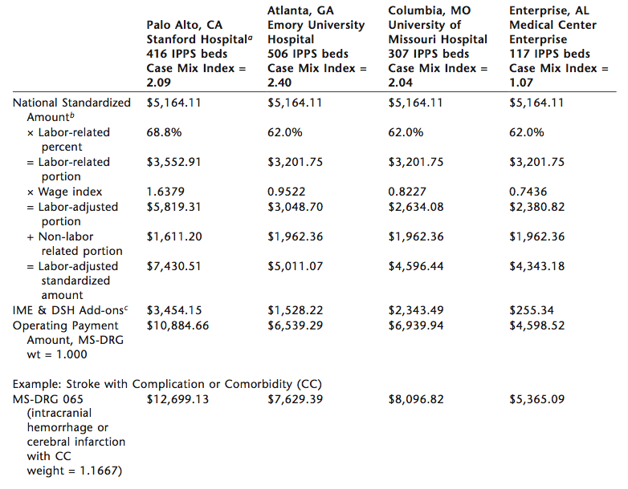
Calculating Medicare PPS Payments
Source: IOM, 2009
© Cooper, Craig, Gaynor, and Van Reenen

Slide 13
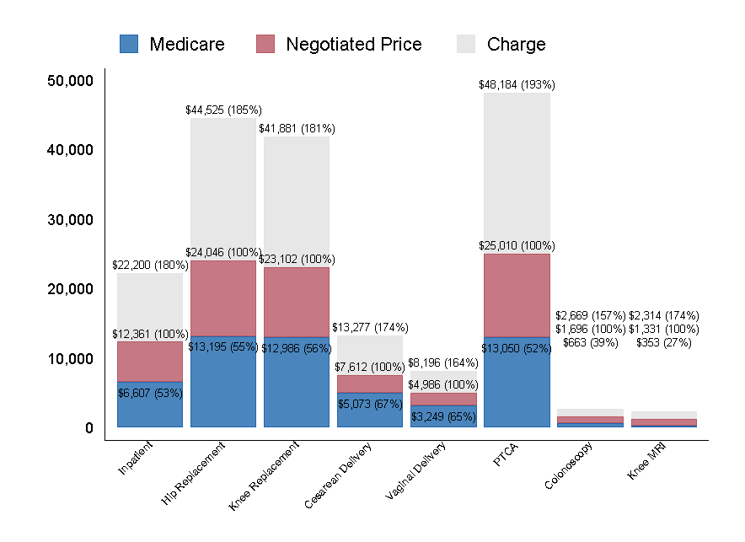
Charge/Negotiated Price/Medicare Fee Ratio
Notes: Prices are averaged from 2008 – 2011, put in 2011 dollars. Note that we only include hospital-based prices – so we exclude, for example, colonoscopies performed in surgical centers and MRIs that are not carried out in hospitals.
© Cooper, Craig, Gaynor, and Van Reenen

Slide 14
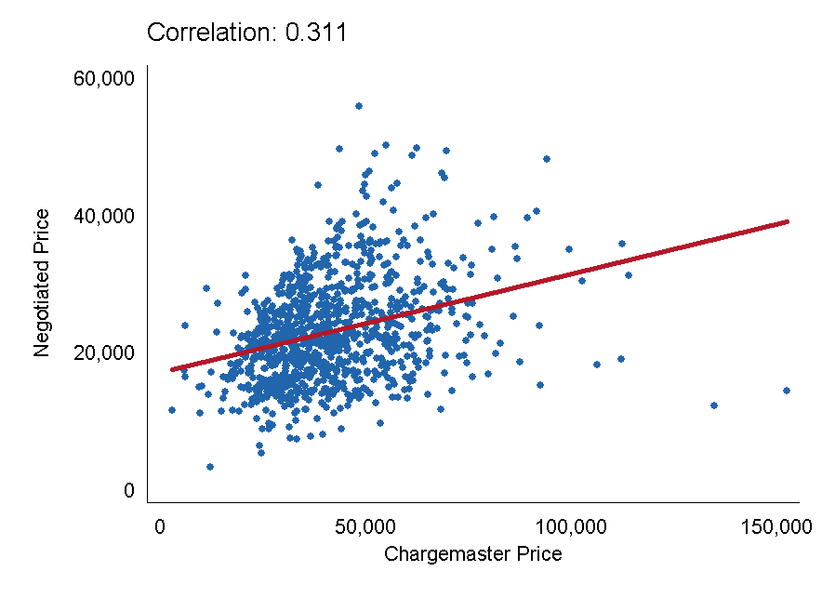
Knee Replacement Negotiated Prices and Charges ‘08 – ‘11
Notes: Regression-adjusted prices presented in 2011 dollars
© Cooper, Craig, Gaynor, and Van Reenen

Slide 15
Correlation Across Price Measures
 | Correlation
 | Inpatient | Hip Replacement | Knee Replacement | Cesarean Section | Vaginal Delivery | PTCA | Colonoscopy | Lower Limb MRI | Medicare Base
Inpatient | 1
Hip Replacement | 0.732 | 1
Knee Replacement | 0.760 | 0.932 | 1
Cesarean Section | 0.794 | 0.531 | 0.569 | 1
Vaginal Delivery | 0.715 | 0.531 | 0.506 | 0.866 | 1
PTCA | 0.691 | 0.602 | 0.598 | 0.408 | 0.345 | 1
Colonoscopy | 0.370 | 0.237 | 0.282 | 0.361 | 0.327 | 0.229 | 1
Lower Limb MRI | 0.423 | 0.275 | 0.305 | 0.295 | 0.246 | 0.347 | 0.307 | 1
Medicare Base | 0.165 | 0.217 | 0.144 | 0.232 | 0.298 | 0.059 | 0.091 | -0.001 | 1
Notes: These are the regression corrected transaction prices as discussed in Section III and the Medicare base reimbursement averaged 2008-11 using inflation adjusted prices in 2011 dollars. Correlation coefficients are pairwise correlations between multiple procedures at the same hospital. The inpatient prices come from the Inpatient sample. The procedure prices come from the Procedure samples.
© Cooper, Craig, Gaynor, and Van Reenen

Slide 16
Spending Analysis and Decomposition
© Cooper, Craig, Gaynor, and Van Reenen

Slide 17
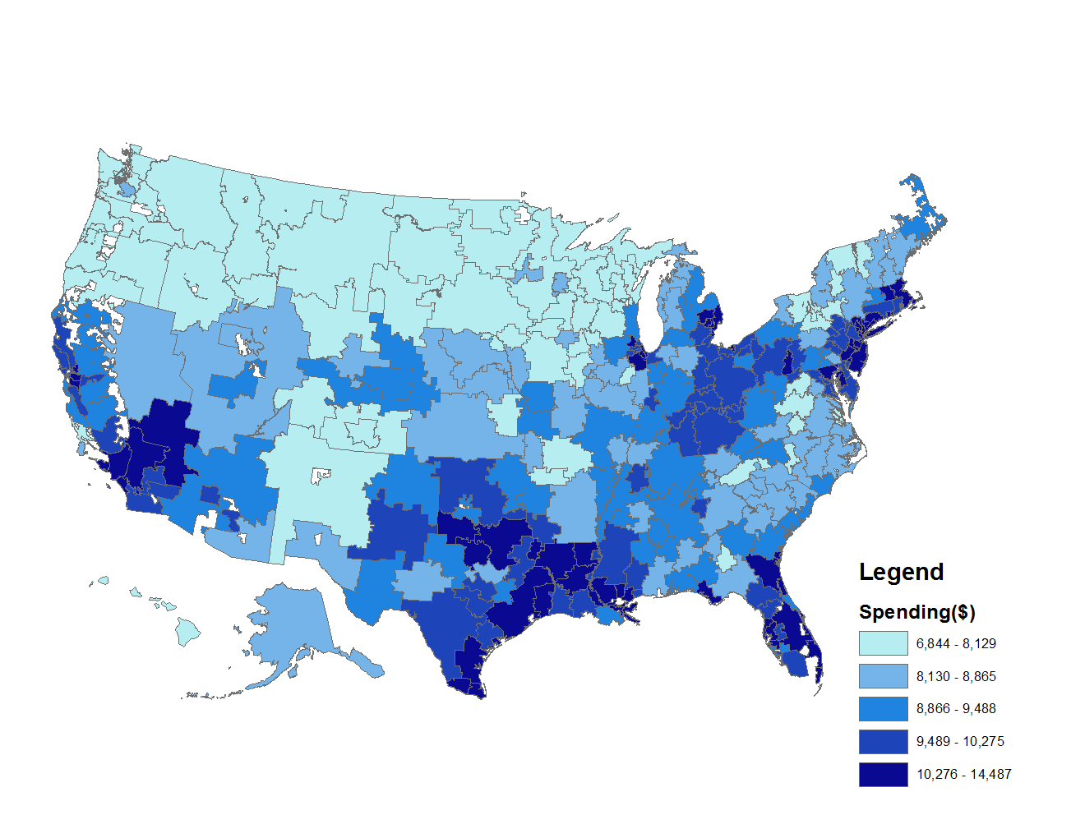
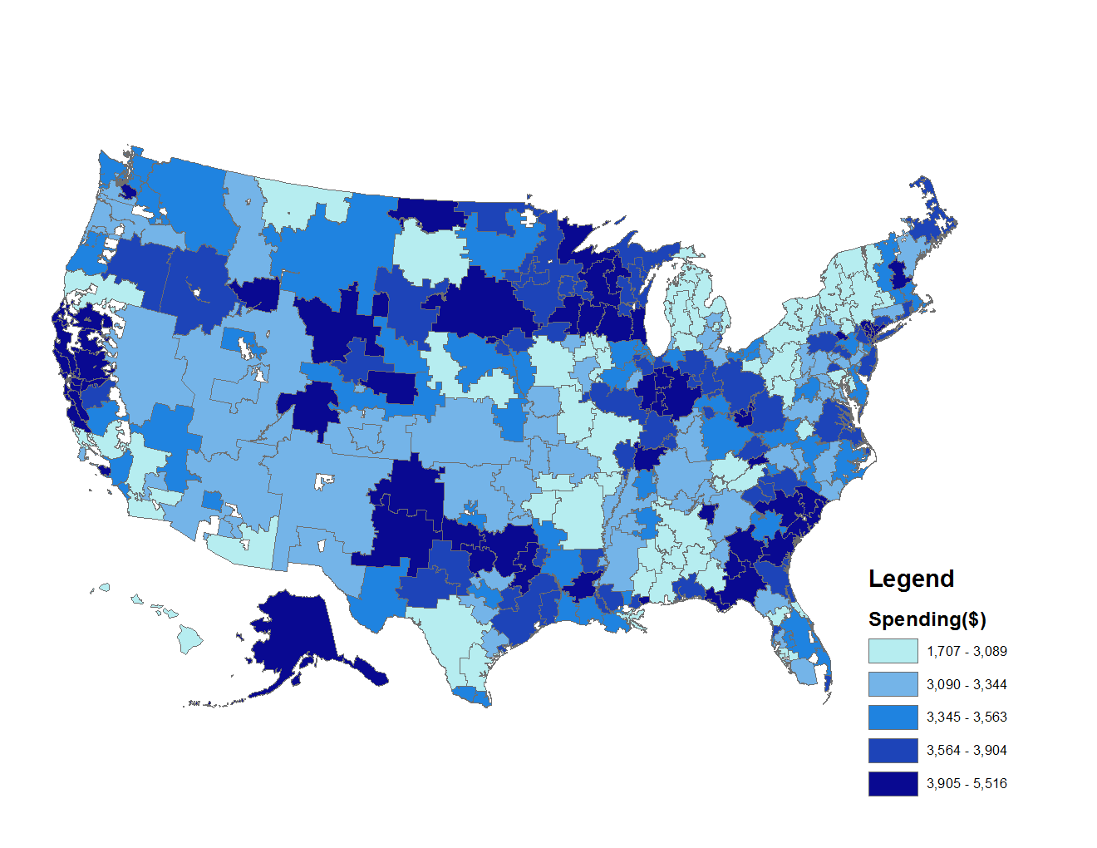
Medicare and ESI Overall Spending Per Beneficiary
Correlation of Public and Private Total Spending Per Beneficiary: 0.140
Note: Data on Medicare is for 2011 and from the Dartmouth Atlas. Spending for Medicare beneficiaries includes Part A & B and is risk adjusted by age, race, and sex. Spending on private enrollees is adjusted by age and sex and includes all inpatient, outpatient, and physician claims
© Cooper, Craig, Gaynor, and Van Reenen

Slide 18
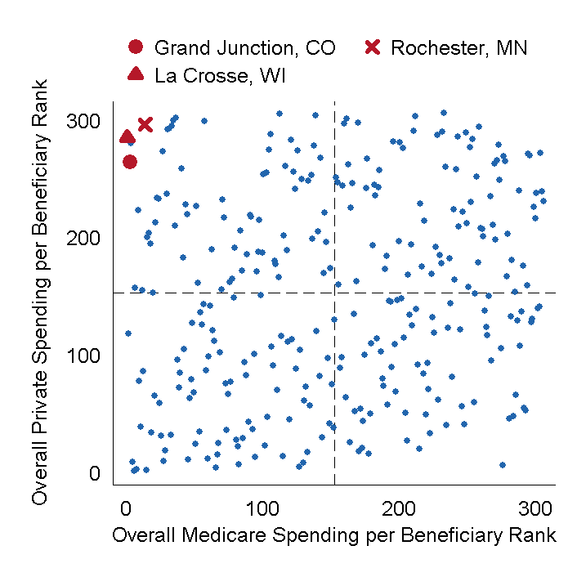
Scatter Plot of Ranking of Medicare Spending Per Beneficiary and Private Spending Per Beneficiary
Notes: Data on Medicare spending was downloaded from the Dartmouth Atlas http://www.dartmouthatlas.org/. An HRR with a rank of 1 has the lowest spending per beneficiary of all HRRs. An HRR with a rank of 306 has the highest spending per beneficiary of all HRRs. Overall spending does not include pharmaceutical spending.
© Cooper, Craig, Gaynor, and Van Reenen

Slide 19
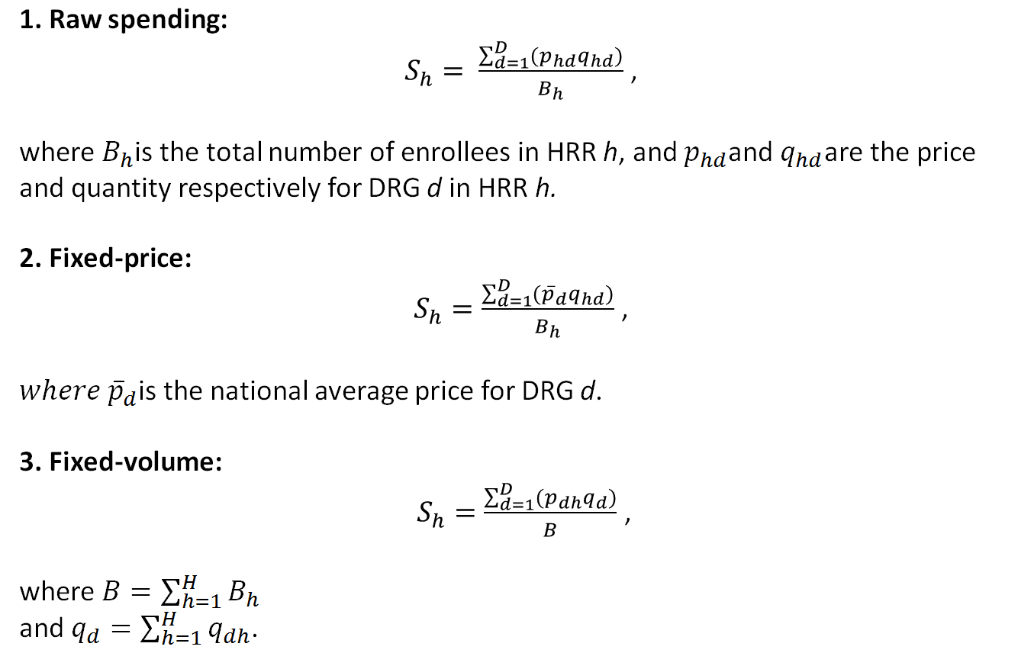
Decomposing the Impact of Price and Volume on Spending
© Cooper, Craig, Gaynor, and Van Reenen

Slide 20
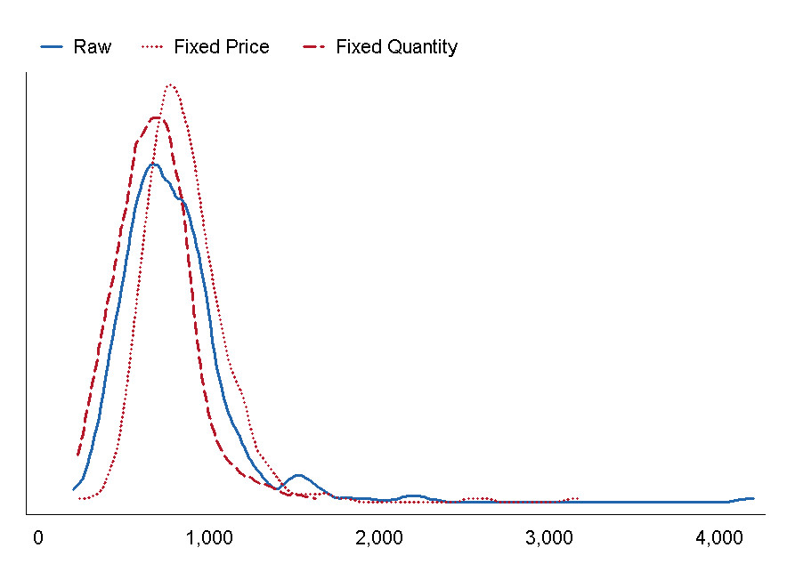
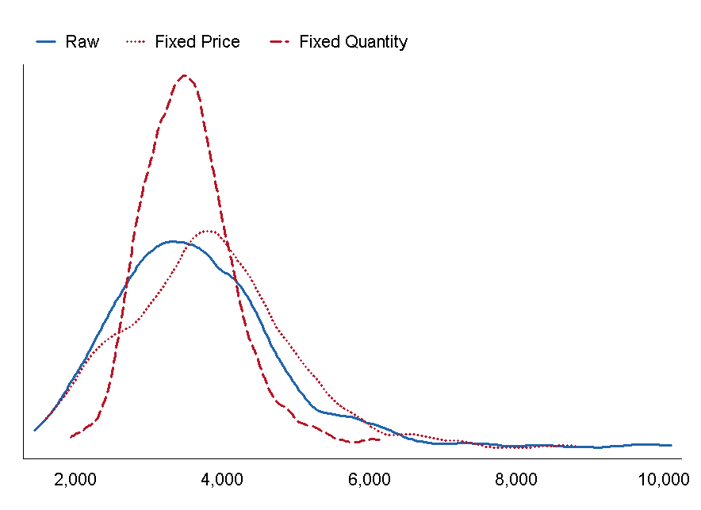
Spending Per Beneficiary with Fixed Prices and Quantities
Panel A: Private
Panel B: Medicare
© Cooper, Craig, Gaynor, and Van Reenen

Slide 21
Decomposing the Impact of Price and Volume on Spending
 | (1) | (2) | (3) |  | (4) | (5) | (6)
 | Private |  |  |  | Medicare
 | Raw | Fix Price at National Level | Fix Quantity at National Level |  | Raw | Fix Price at National Level | Fix Quantity at National Level
Mean | 793 | 862 | 680 |  | 3,704 | 3,820 | 3,544
SD | 348 | 273 | 223 |  | 1,281 | 1,157 | 655
Coefficient of Variation | 0.44 | 0.32 | 0.33 |  | 0.35 | 0.30 | 0.18
Gini | 0.20 | 0.15 | 0.18 |  | 0.18 | 0.17 | 0.10
p90/p10 | 1.85 | 1.64 | 1.76 |  | 1.81 | 1.72 | 1.39
N | 306 | 306 | 306 |  | 306 | 306 | 306
Medicare Spending: Volume plays dominant role driving variation in spending across markets.
Private Spending: Price and volume differences across market play a large role driving variation in inpatient spending per beneficiary across markets;
Note: Medicare data is for all inpatient care from the American Hospital Directory
© Cooper, Craig, Gaynor, and Van Reenen

Slide 22



Formal Decompositions of Variance
The variance of spending per DRG d may be decomposed into three components:
•
Captures share of variance in spending attributable to variation in prices across HRRs
•
Captures share of variance in spending attributable to variation in the quantity of care across HRRs
•
The covariance term captures the share of variance attributable to the covariance of price and quantity.
Come up with price/quantity contribution by averaging DRG results by spending per DRG
© Cooper, Craig, Gaynor, and Van Reenen

Slide 23
Decomposition Results
 | Private |  |  |  | Medicare
 | Share Price | Share Quantity | Share Covariance |  | Share Price | Share Quantity | Share Covariance
Cardiac valve & oth maj cardiothoracic proc w/o card cath w CC | 51.2% | 17.8% | 31.0% |  | 11.7% | 48.1% | 40.3%
Cardiac valve & oth maj cardiothoracic proc w/o card cath w MCC | 50.4% | 13.4% | 36.2% |  | 11.3% | 46.8% | 41.8%
Cellulitis w/o MCC | 39.2% | 97.4% | -36.6% |  | 7.3% | 96.8% | -4.1%
Circulatory disorders except AMI, w card cath w/o MCC | 43.6% | 60.2% | -3.8% |  | 6.6% | 101.1% | -7.7%
Coronary bypass w cardiac cath w/o MCC | 56.1% | 14.2% | 29.8% |  | 6.1% | 72.2% | 21.7%
Craniotomy & endovascular intracranial procedures w MCC | 40.8% | 19.0% | 40.2% |  | 7.8% | 54.5% | 37.8%
Esophagitis, gastroent & misc digest disorders w/o MCC | 57.7% | 80.3% | -38.0% |  | 10.7% | 104.3% | -15.0%
Infectious & parasitic diseases w O.R. procedure w MCC | 67.2% | 5.0% | 27.8% |  | 9.0% | 62.4% | 28.6%
Kidney & urinary tract infections w/o MCC | 53.8% | 87.2% | -41.0% |  | 9.9% | 107.2% | -17.0%
Major cardiovasc procedures w MCC or thoracic aortic anuerysm repair | 59.7% | 9.6% | 30.7% |  | 11.7% | 52.1% | 36.3%
Major cardiovascular procedures w/o MCC | 52.1% | 26.5% | 21.3% |  | 10.9% | 69.6% | 19.5%
Major joint replacement or reattachment of lower extremity w/o MCC | 55.4% | 73.6% | -28.9% |  | 12.3% | 101.7% | -14.0%
Average Shares (weighted by spending) | 45.9% | 36.2% | 17.9% |  | 9.4% | 76.6% | 14.0%
© Cooper, Craig, Gaynor, and Van Reenen

Slide 24
National Variation in Prices
© Cooper, Craig, Gaynor, and Van Reenen

Slide 25
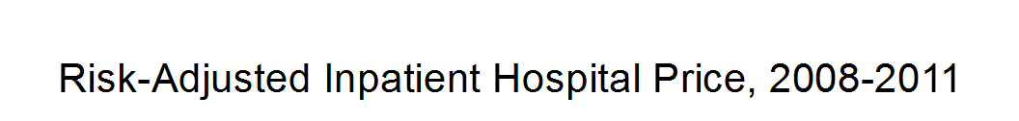
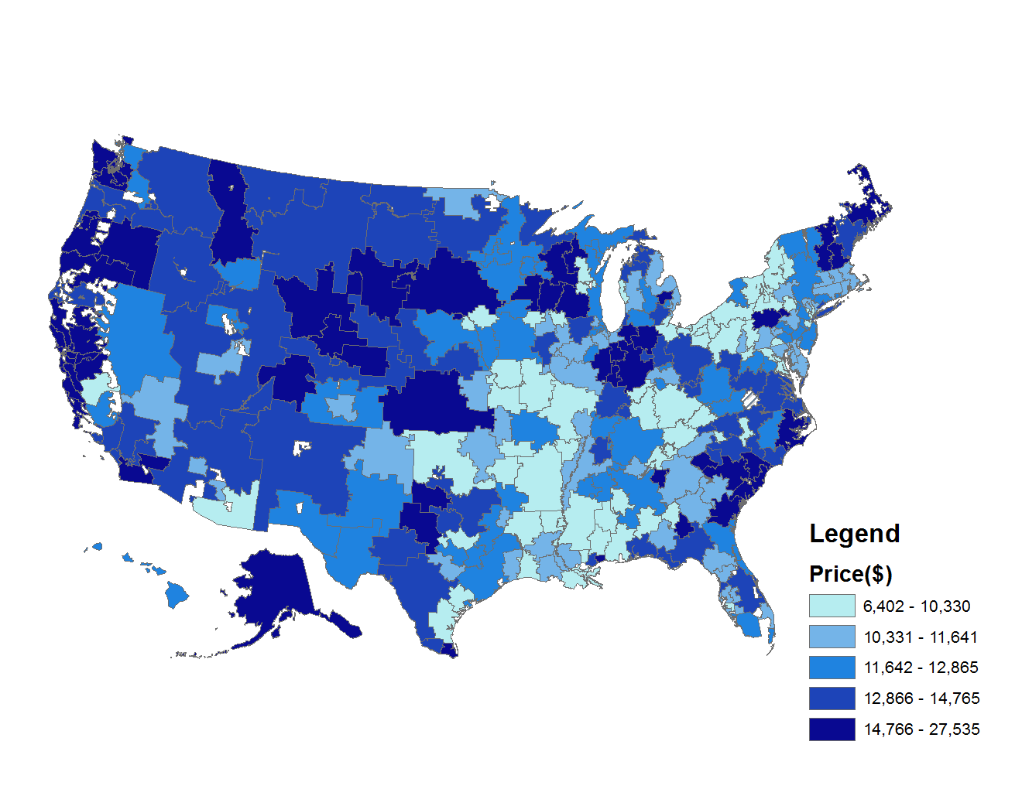
Inpatient Prices
© Cooper, Craig, Gaynor, and Van Reenen

Slide 26
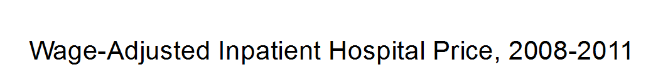
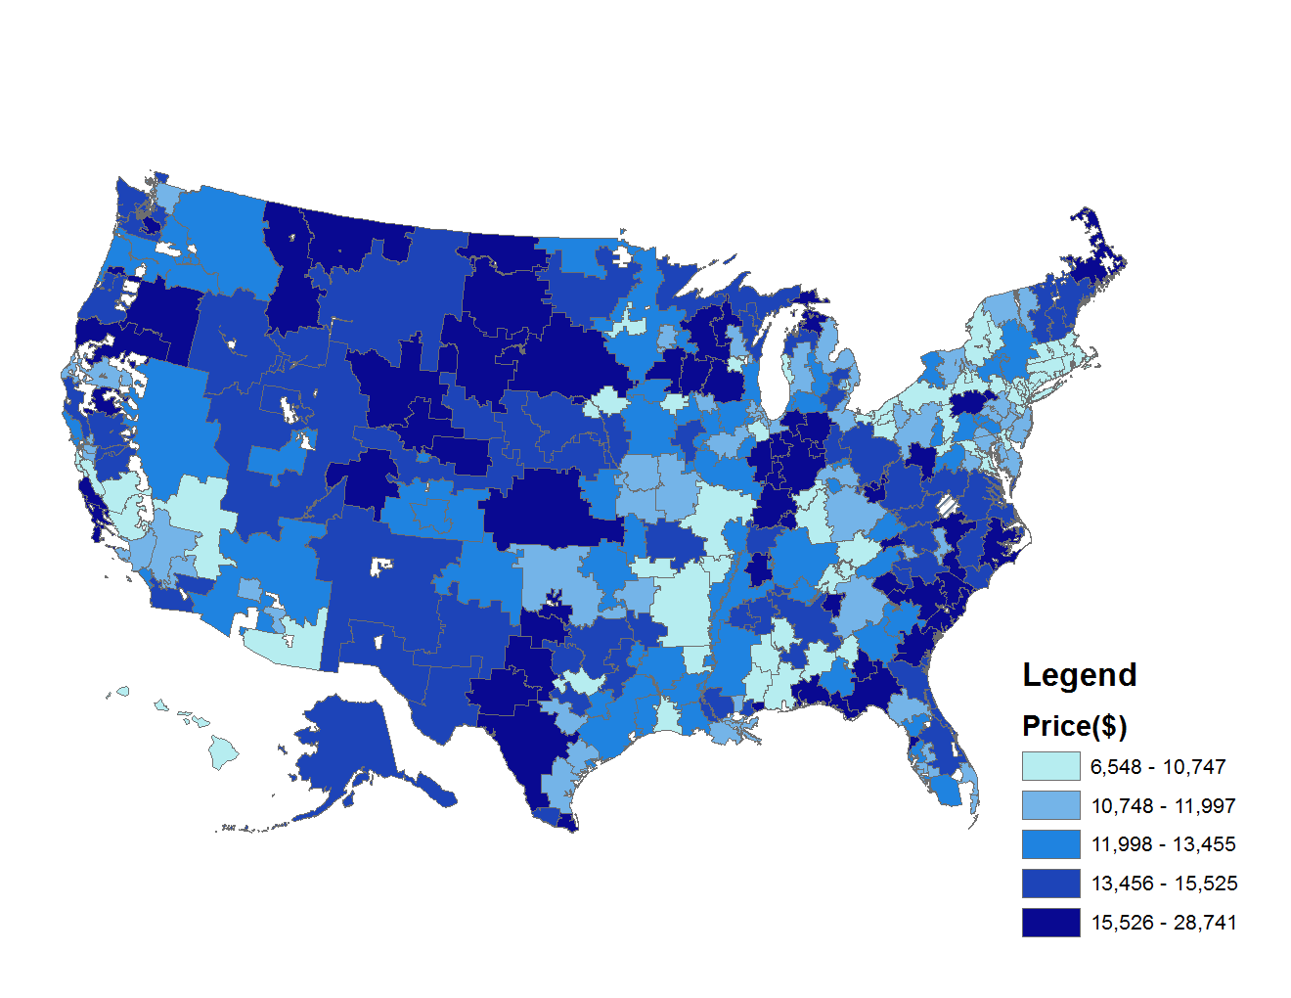
Inpatient Prices—normalized using the wage index
© Cooper, Craig, Gaynor, and Van Reenen

Slide 27
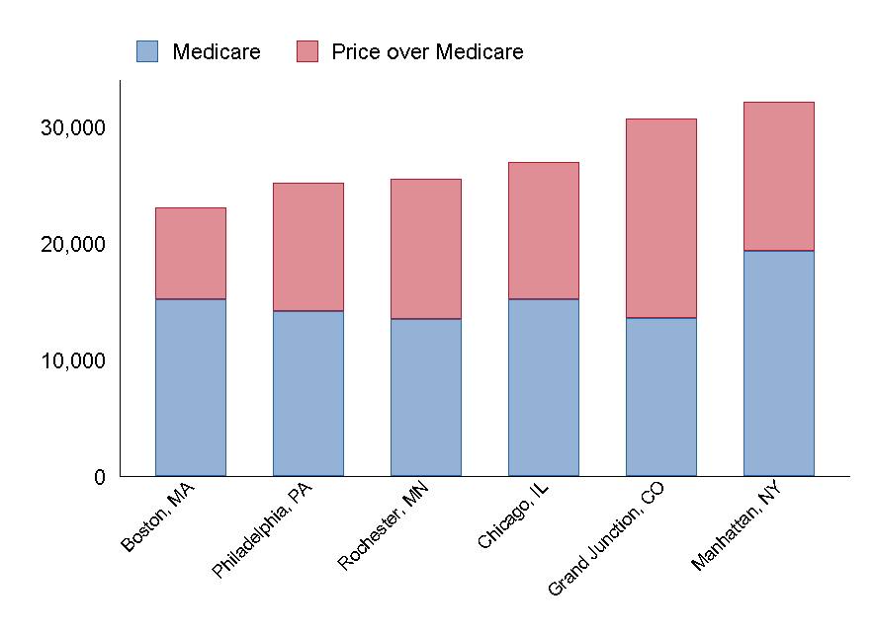
The Price of a Knee Replacement is Higher in South Dakota than it is in Manhattan
© Cooper, Craig, Gaynor, and Van Reenen

Slide 28
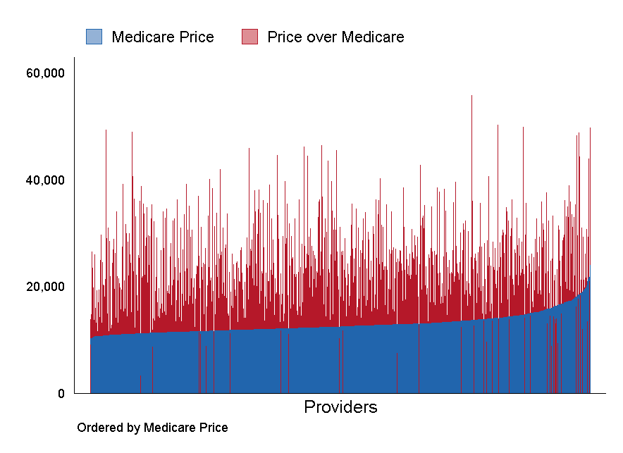
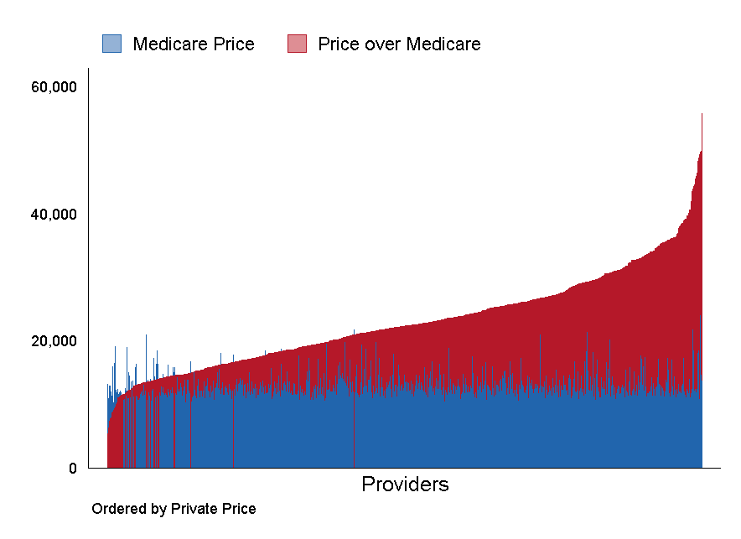
National Variation in Prices and Medicare Fees: Knee Replacement
Medicare Knee Replacement Prices
Private Knee Replacement Prices
Mean |  | 12,986
Min - Max |  | 10,254 - 24,021
p10-p90 |  | 11,213 - 15,441
IQR |  | 11,734 - 13,605
p90/10 ratio |  | 1.38
IQR ratio |  | 1.16
Coefficient of Variation |  | 0.15
Gini Coefficient |  | 0.07
Mean |  | 23,102
Min - Max |  | 3,298 - 55,825
p10-p90 |  | 14,338 - 33,236
IQR |  | 17,365 - 27,151
p90/10 ratio |  | 2.32
IQR ratio |  | 1.56
Coefficient of Variation |  | 0.33
Gini Coefficient |  | 0.18
Note: Each column is a hospital; Medicare prices are calculated using Medicare Impact Files
© Cooper, Craig, Gaynor, and Van Reenen

Slide 29
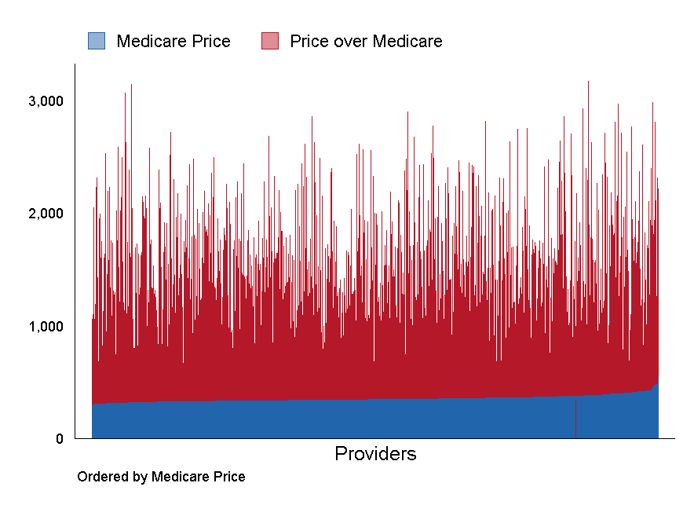
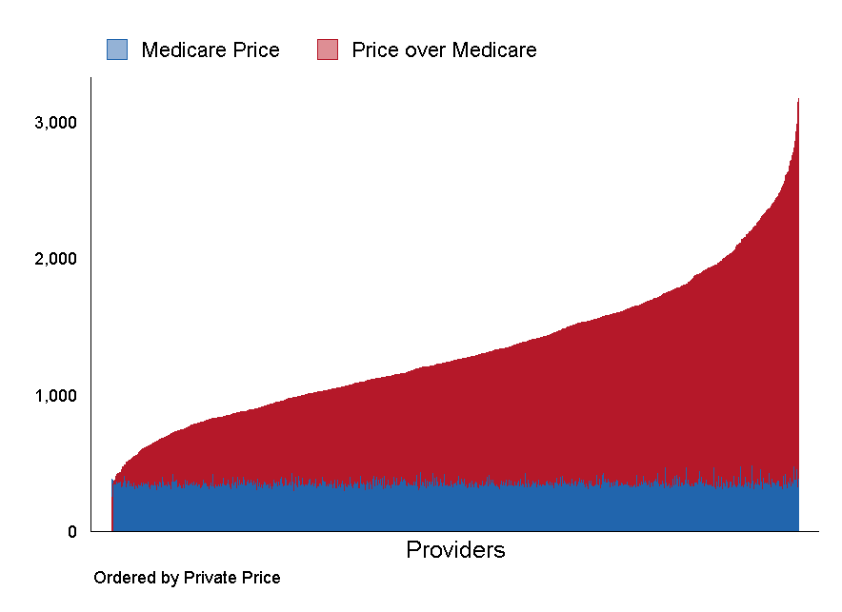
National Variation in Prices and Medicare Fees: Knee MRI
Medicare Knee MRI Prices
Private Knee MRI Prices
Mean |  | 353
Min - Max |  | 293 - 546
p10-p90 |  | 325 - 389
IQR |  | 335 - 366
p90/10 ratio |  | 1.2
IQR ratio |  | 1.09
Coefficient of Variation |  | 0.08
Gini Coefficient |  | 0.04
Mean |  | 1,331
Min - Max |  | 260 - 3,174
p10-p90 |  | 745 - 2,036
IQR |  | 960 - 1,629
p90/10 ratio |  | 2.73
IQR ratio |  | 1.70
Coefficient of Variation |  | 0.38
Gini Coefficient |  | 0.21
Note: Each column is a hospital; Medicare prices are calculated using Medicare Impact Files
© Cooper, Craig, Gaynor, and Van Reenen

Slide 30
Within Market Variation in Prices
© Cooper, Craig, Gaynor, and Van Reenen

Slide 31
Divergence from Law of One Price in Non-Health Markets
Food Staples
Coefficient of variation for 36oz bottles of Ketchup purchased in Minneapolis in 2007: 0.23
        [Kaplan and Menzio (2014]
Pharmaceuticals
Within markets, the highest posted price for an RX is over 50% above lowest available price [Sorenson, 2000]
Online Electronics
Coefficient of variation for sale of online electronics: 0.126
[Baye et al., 2004]
Vocal Lessons
Vocal lessons in Boston area have a coefficient of variation of 0.38
[Pratt, Wise, and Zeckhauser, 1979]
© Cooper, Craig, Gaynor, and Van Reenen

Slide 32
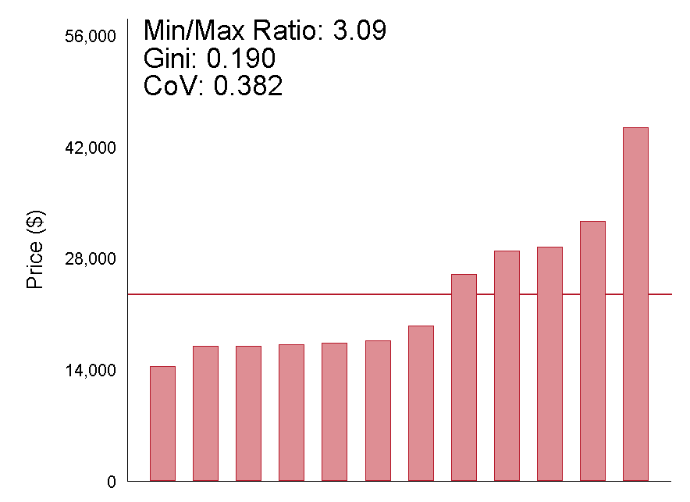
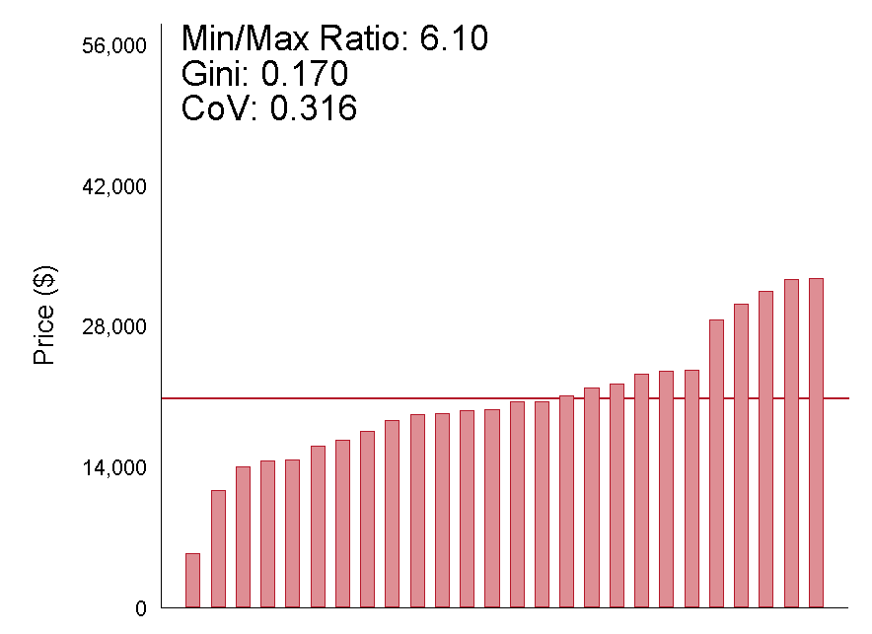
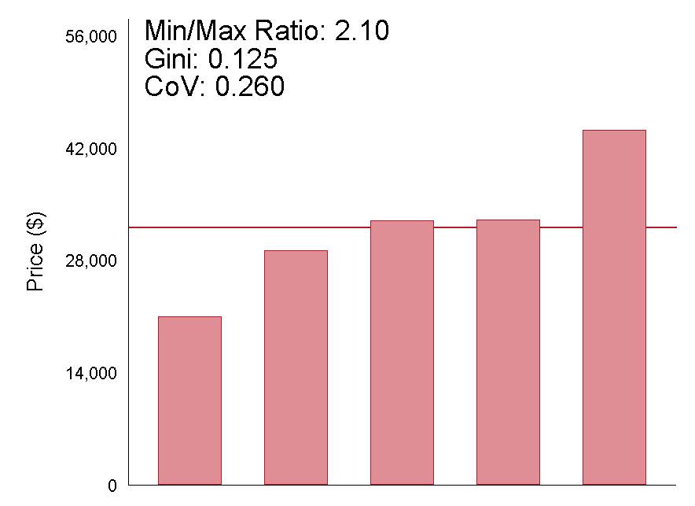
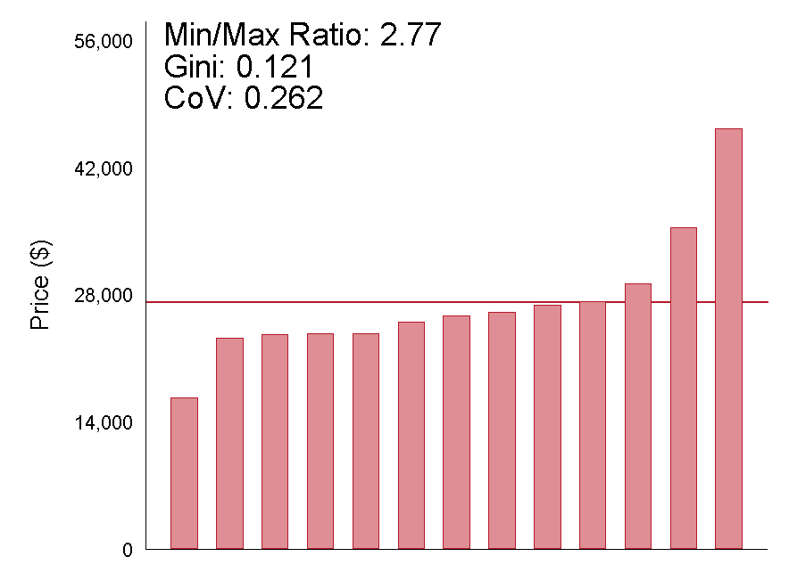
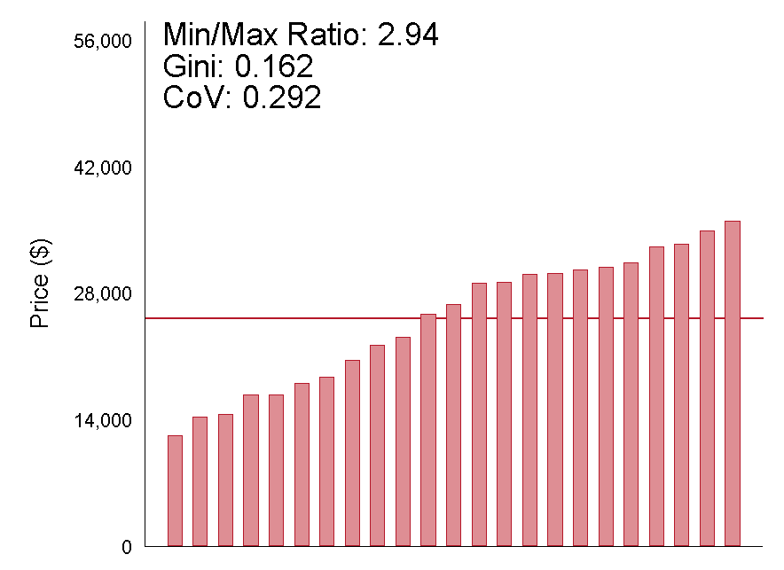
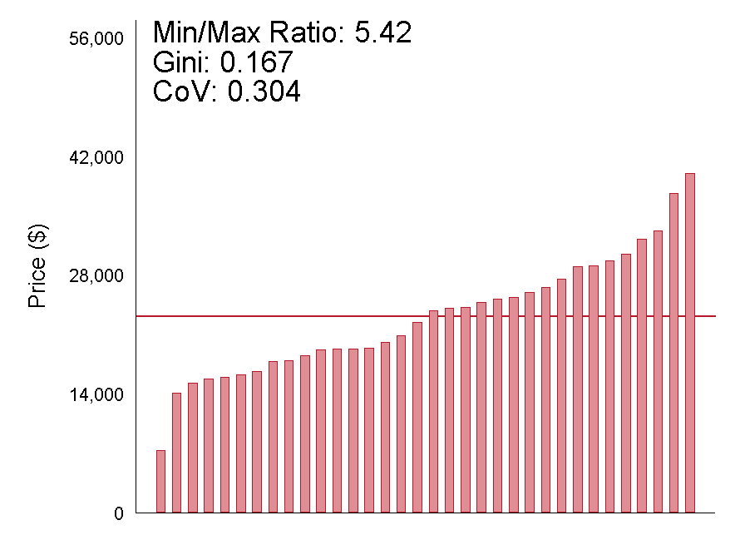
Knee Replacement Facility Prices Within Markets
Denver, CO | Atlanta, GA | Manhattan, NY
Columbus, OH | Philadelphia, PA | Houston, TX
Note: Each column is a hospital. Prices are regression-adjusted, measured from 2008 – 2011, and presented in 2011 dollars.
© Cooper, Craig, Gaynor, and Van Reenen

Slide 33
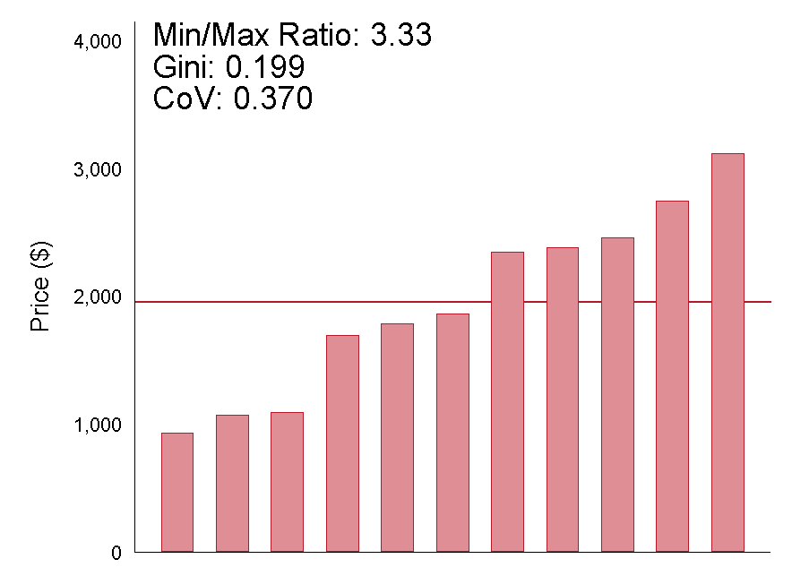
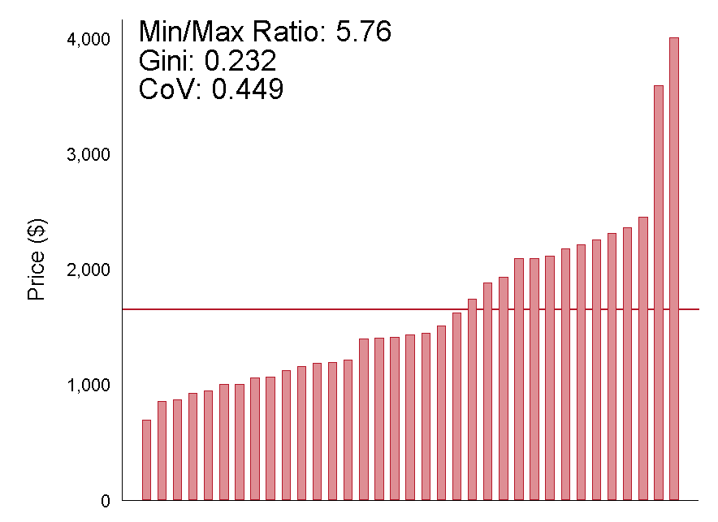
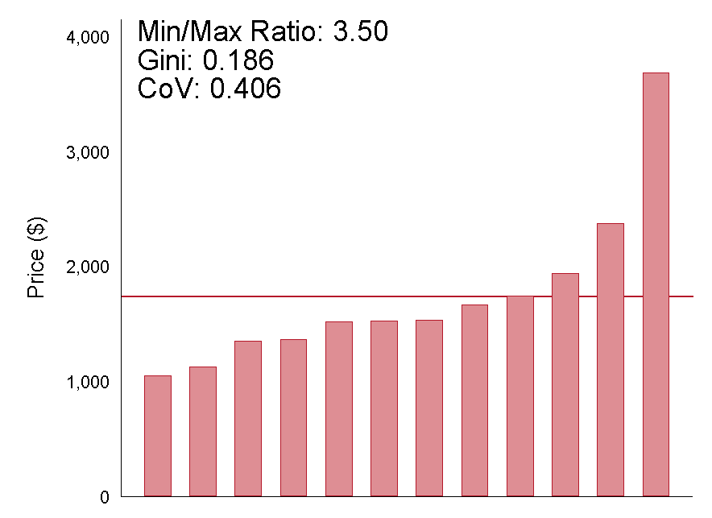
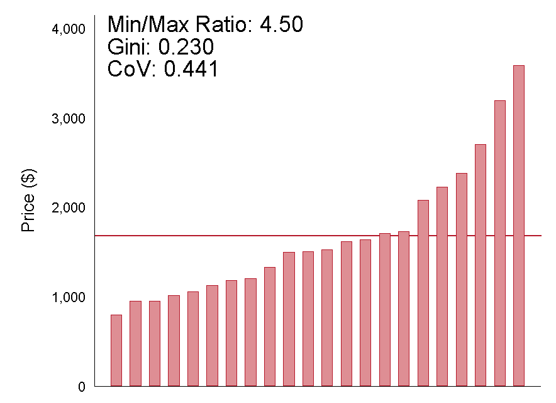
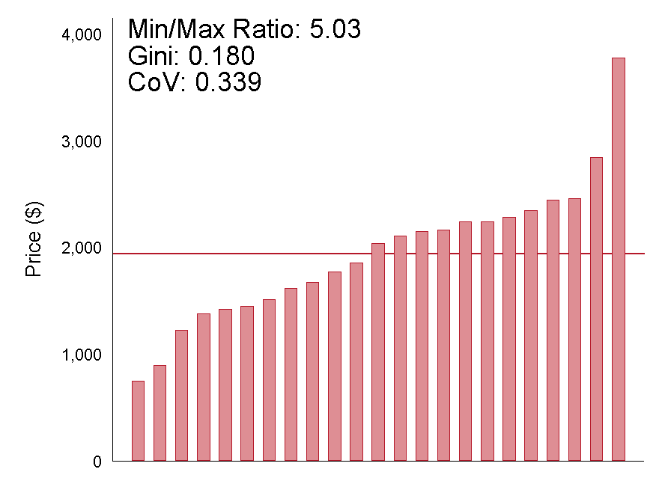
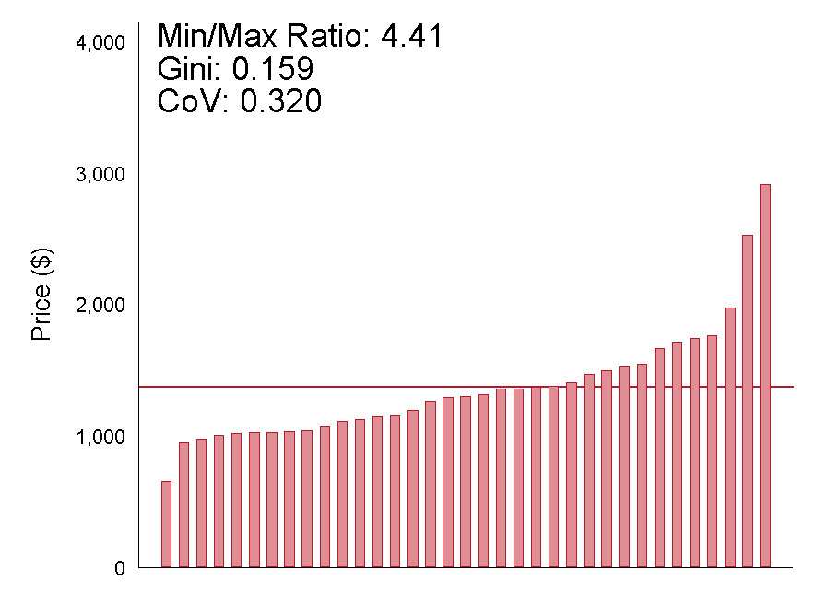
Colonoscopy Facility Prices Within Markets
Denver, CO | Atlanta, GA | Manhattan, NY
Columbus, OH | Philadelphia, PA | Houston, TX
Note: Each column is a hospital. Prices are regression-adjusted, measured from 2008 – 2011, and presented in 2011 dollars.
© Cooper, Craig, Gaynor, and Van Reenen

Slide 34
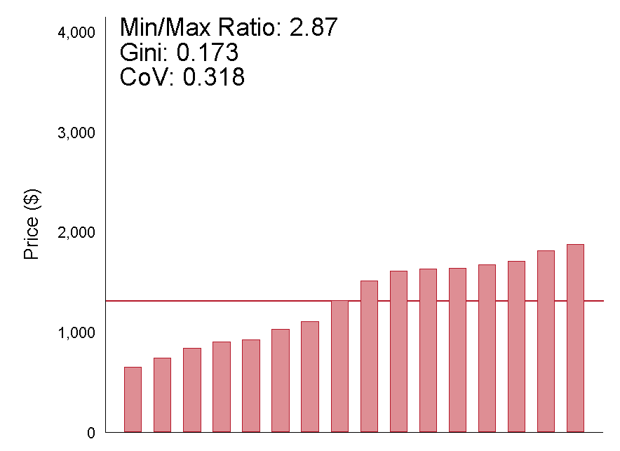
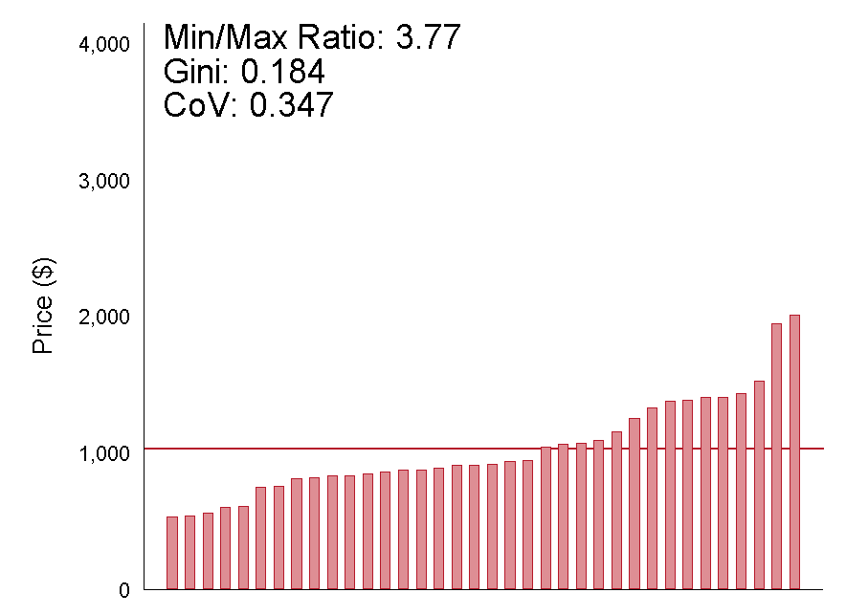
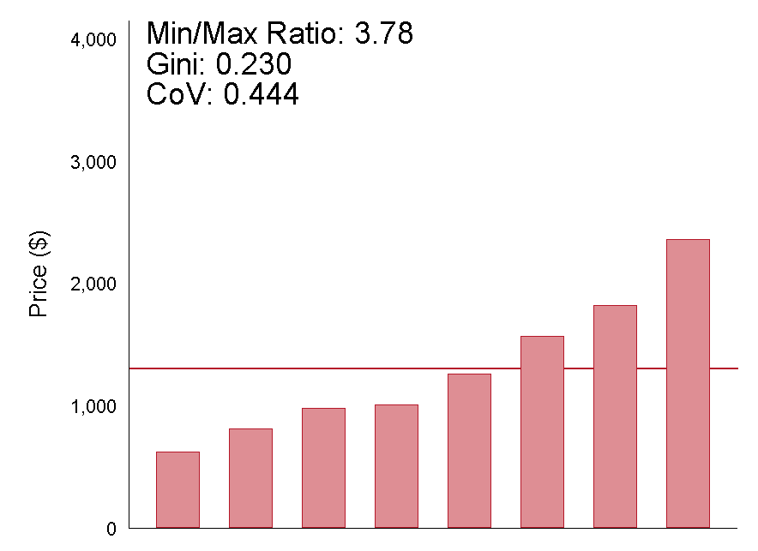
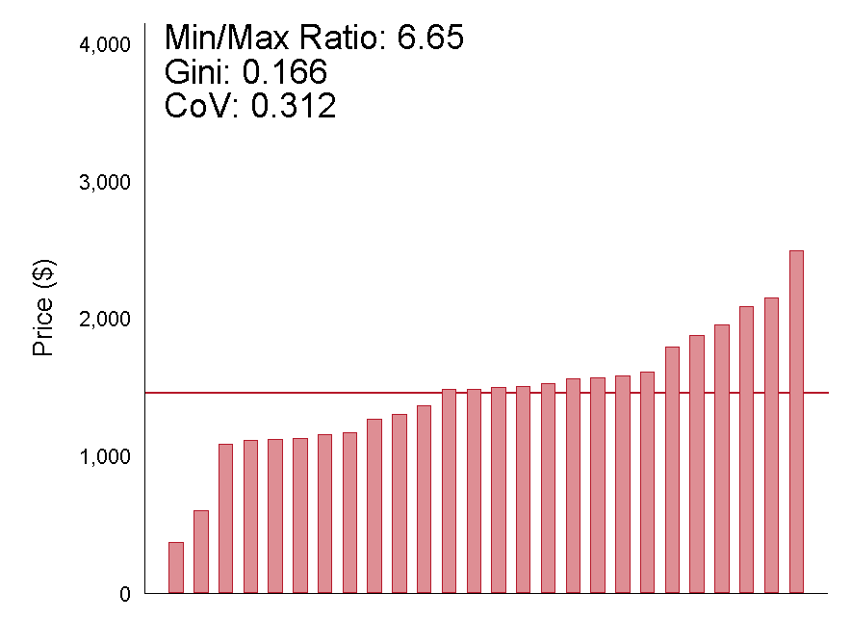
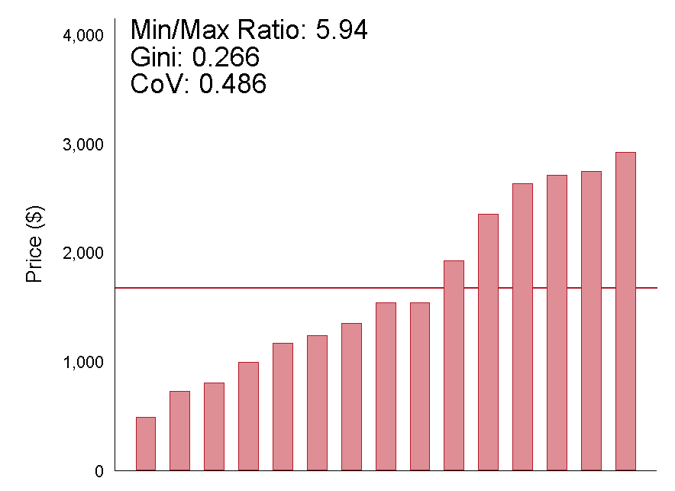
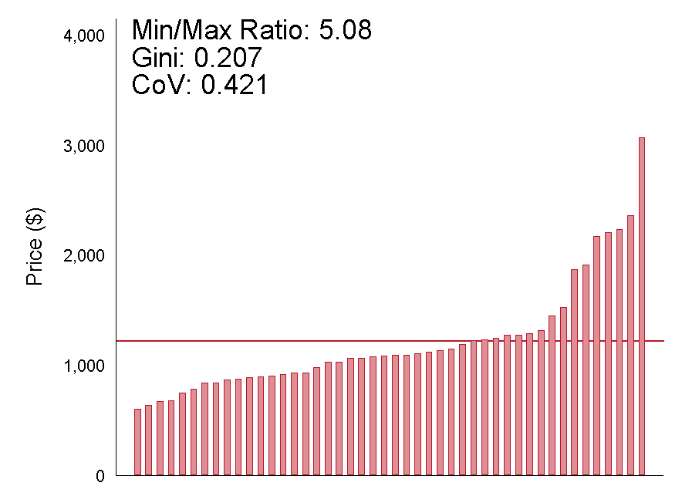
Lower Limb MRI Facility Prices Within Markets
Denver, CO | Atlanta, GA | Manhattan, NY
Columbus, OH | Philadelphia, PA | Houston, TX
Note: Each column is a hospital. Prices are regression-adjusted, measured from 2008 – 2011, and presented in 2011 dollars.
© Cooper, Craig, Gaynor, and Van Reenen

Slide 35
Drivers of Price Variation
© Cooper, Craig, Gaynor, and Van Reenen

Slide 36
Drivers of Price Variation
Providers’ Negotiated Prices
What is driving price
growth and variation?
Quality of the Provider?
Clinical quality
Hotel-related services
Perceived quality
Hospital & Local Area Characteristics?
Teaching status
Ownership
Hospital size
Local costs
Local wage rates
Medicare/Medicaid Penetration?
Hospitals’ share of patients funded by Medicare or Medicaid
Medicare payment rates
Share of uninsured
Market Structure?
Provider market structure
Payer market structure
© Cooper, Craig, Gaynor, and Van Reenen
35

Slide 37
Construction of Explanatory Variables
Provider Market Concentration
      HHIs and hospital counts in fixed radius markets (5m, 10m, 15m, 30m radius), activity defined by beds (AHA);
      HHIs and counts in variable radius markets (10m large urban, 15m urban, 20m rural), activity by beds;
      Illustrate robust across each;
  Insurance Market Concentration
      State level HHIs for the large insurance group market;
      Constructed using data from the Consumer Information and Insurance Oversight Panel (CCIIO) at the Centers for Medicare and Medicaid;
      HCCI patients as a percentage of a county’s privately insured population.
© Cooper, Craig, Gaynor, and Van Reenen

Slide 38
Additional Controls
Medicare and Medicaid Controls
Medicare wage index;
Medicare discharges as a share of hospitals’ total discharges; Medicaid discharges as a share of total hospital discharges
County-Level Controls
Share insured;
Median county income;
Range of Hospital Characteristics from the AHA
Teaching Status, ownership, case-mix, size, etc.;
Measure hospitals’ of use of technology;
© Cooper, Craig, Gaynor, and Van Reenen

Slide 39
Measures of Hospital Quality
Perceived Quality
Indicated whether a hospital was ranked in the year by the US News and World Report Annual Hospital Rating (ranked in any category);
Quality Measures
AHRQ hospital-level outcomes, process and patient safety indicators composed of claims from publicly and privately funded patients;
          % of AMI patients given aspirin at arrival;
          % of surgical patients given antibiotic pre-surgery;
          % of patients who received treatment within 24 hours of surgery to prevent clots;
          30-day risk-adjusted AMI mortality
© Cooper, Craig, Gaynor, and Van Reenen

Slide 40
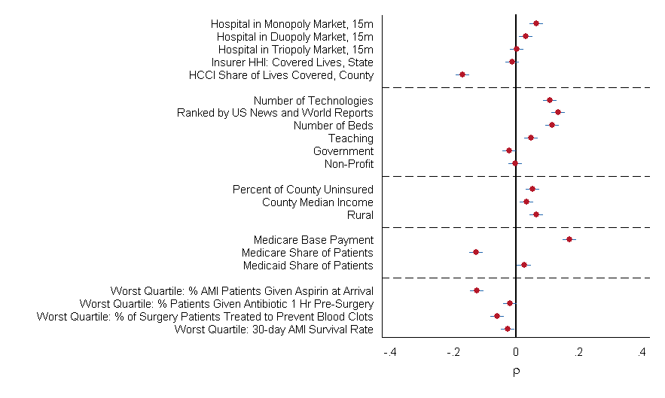
Bivariate Correlations: Price and Local and Hospital Characteristics
Notes: The x-axis captures the correlations between key variables featured in our regression and our hospitals’ inpatient prices averaged from 2008 – 2011 and inflation adjusted into 2011 dollars. The bars capture the 95% confidence intervals surrounding the correlations.
© Cooper, Craig, Gaynor, and Van Reenen

Slide 41
Estimating Equation
Ln(Price_{h,m,r,c,s,t} ) = H_{m,t}α + β I_{s,} + φS_{c,t} + Z_{h,t} γ + D_{c,t}θ + M_{h,t}μ + τ_{t} + ε_{h,m,r,s,t}
H_{h,t} | Hospital market structure (various definitions)
I_{s} | Insurer market structure annually at the state-level
S_{c,t} | Share of county privately insured covered by HCCI data contributors annually.
Z_{h,t} | Hospital characteristics (technology, teaching status, ownership, size, US News rankings, HCCI share of private discharges)
D_{c,t} | County demand shifters (local income, unemployment rate)
M_{h,t} | Medicare base payment rate, hospitals’ share of Medicare patients; hospitals share of Medicaid patients
τ_{t} | Year fixed effects
ε_{h,m,r,s,t} | Error term that is clustered at the HRR-level
© Cooper, Craig, Gaynor, and Van Reenen

Slide 42
Inpatient Price Regression Estimates
 | Dependent Variable: | Ln(Facilities Price) |  |  |  | Ln(Facilities Charge)
Market Characteristics
 | Monopoly | 0.232*** | 0.169*** | 0.142*** |  | -0.006
 |  | (0.027) | (0.033) | (0.029) |  | (0.024)
 | Duopoly | 0.162*** | 0.084*** | 0.062** |  | 0.004
 |  | (0.024) | (0.027) | (0.025) |  | (0.024)
 | Triopoly | 0.121*** | 0.063** | 0.047* |  | -0.004
 |  | (0.028) | (0.029) | (0.028) |  | (0.026)
 | Ln Insurer HHI |  |  | -0.249 |  | 0.163
 |  |  |  | (0.312) |  | (0.318)
 | Ln Share HCCI |  |  | -0.138*** |  | -0.028
 |  |  |  | (0.034) |  | (0.03)
Hospital Characteristics
 | Ln Technologies | 0.009 | 0.009** | 0.009* |  | 0.013**
 |  | (0.005) | (0.004) | (0.004) |  | (0.006)
 | Ranked by US News and World Reports | 0.115*** | 0.125*** | 0.127*** |  | 0.012
 |  | (0.034) | (0.036) | (0.036) |  | (0.038)
 | Ln Number of Beds | 0.051*** | 0.069*** | 0.069*** |  | 0.044***
 |  | (0.013) | (0.013) | (0.013) |  | (0.012)
 | Teaching Hospital | -0.003 | 0.008 | 0.008 |  | -0.028
 |  | (0.018) | (0.016) | (0.016) |  | (0.017)
 | Government Owned | -0.107*** | -0.119*** | -0.122*** |  | -0.298***
 |  | (0.035) | (0.036) | (0.036) |  | (0.026)
 | Non-Profit | -0.007 | -0.031 | -0.033 |  | -0.204***
 |  | (0.026) | (0.029) | (0.029) |  | (0.024)
Other Payers
 | Ln Medicare Base Payment Rate | 0.333*** | 0.017 | 0.035 |  | 0.101
 |  | (0.08) | (0.088) | (0.089) |  | (0.099)
 | Ln Share Medicare | -0.097*** | -0.107*** | -0.105*** |  | -0.093***
 |  | (0.028) | (0.03) | (0.03) |  | (0.026)
 | Ln Share Medicaid | -0.027 | -0.011 | -0.015 |  | 0.046***
 |  | (0.022) | (0.024) | (0.025) |  | (0.014)
 | HRR FE | No | Yes | Yes |  | Yes
 | R-square | 0.117 | 0.382 | 0.388 |  | 0.555
OLS estimates for 8,176 hospital-year observations with standard errors clustered at the HRR-level in parentheses. Facilities prices are regression adjusted transaction prices. Facilities charges are regression adjusted list prices. All regressions include yearly fixed effects, and controls for county insurance rate and median income.
© Cooper, Craig, Gaynor, and Van Reenen

Slide 43
Inpatient Price Regression Estimates with Multiple Measures of Hospital Market Concentration
 |  | (1) | (2) | (3) | (4) | (5) | (6) | (7)
 |  | Ln(Facilities Price)
Hospital Market Structure
 | Ln HHI | 0.169*** | 0.338*** | 0.409*** | 0.248***
 |  | (0.065) | (0.057) | (0.096) | (0.061)
 | Hospital Count |  |  |  |  | -0.065***
 |  |  |  |  |  | (0.018)
 | Q4 HHI |  |  |  |  |  | 0.151*** | 0.094***
 |  |  |  |  |  |  | (0.035) | (0.019)
 | Q3 HHI |  |  |  |  |  | 0.085***
 |  |  |  |  |  |  | (0.031)
 | Q2 HHI |  |  |  |  |  | 0.027
 |  |  |  |  |  |  | (0.026)
 | Radius | 5 mile | 15 mile | 30 mile | Variable | 15 mile | 15 mile | 15 mile
Insurer Market Structure
 | Ln Insurer HHI | -0.256 | -0.210 | -0.219 | -0.204 | -0.203 | -0.232 | -0.250
 |  | (0.332) | (0.307) | (0.316) | (0.327) | (0.333) | (0.312) | (0.318)
 | Ln Share HCCI | -0.163*** | -0.130*** | -0.132*** | -0.149*** | -0.134*** | -0.139*** | -0.150***
 |  | (0.037) | (0.033) | (0.033) | (0.035) | (0.033) | (0.034) | (0.036)
Hospital Characteristics
 | Ln Technologies | 0.009** | 0.009** | 0.010** | 0.009** | 0.009* | 0.009** | 0.009**
 |  | (0.004) | (0.004) | (0.004) | (0.004) | (0.004) | (0.004) | (0.004)
 | Ranked by US News & World Reports | 0.134*** | 0.127*** | 0.128*** | 0.130*** | 0.131*** | 0.128*** | 0.128***
 |  | (0.037) | (0.036) | (0.037) | (0.037) | (0.037) | (0.036) | (0.036)
 | R-sq | 0.383 | 0.391 | 0.386 | 0.387 | 0.387 | 0.389 | 0.386
OLS estimates for 8,176 hospital-year observations with standard errors clustered at the HRR-level in parentheses. Facilities prices are regression adjusted transaction prices. All regressions include HRR and year fixed effects, and controls for number of beds, teaching status, government ownership, non-profit status, county insurance rate and median income, Medicare payment rate, and share of hospital activity covered by Medicare and Medicaid.
© Cooper, Craig, Gaynor, and Van Reenen

Slide 44
Inpatient Regression with Controls for Quality
 |  | (1) | (2) | (3) | (4) | (5) | (6) | (7)
 | Dependent Variable | Ln(Facilities Price)
In bottom quartile of quality for:
 | % AMI pats. given aspirin at arrival |  |  | -0.043*** |  |  |  | -0.037***
 |  |  |  | (0.009) |  |  |  | (0.009)
 | % of surgery pats. given antibiotic 1 hour before surgery |  |  |  | -0.031*** |  |  | -0.020**
 |  |  |  |  | (0.009) |  |  | (0.008)
 | % of surgery pats. given treatment to prevent blood clots within 24 hours |  |  |  |  | -0.040*** |  | -0.031***
 |  |  |  |  |  | (0.010) |  | (0.009)
 | 30-day death rate for heart attack patients |  |  |  |  |  | -0.010 | -0.007
 |  |  |  |  |  |  | (0.010) | (0.010)
Other Characteristics
 | Monopoly | 0.135*** | 0.132*** | 0.134*** | 0.134*** | 0.132*** | 0.133*** | 0.134***
 |  | (0.026) | (0.026) | (0.026) | (0.026) | (0.026) | (0.026) | (0.026)
 | Duopoly | 0.076*** | 0.073*** | 0.073*** | 0.074*** | 0.074*** | 0.073*** | 0.074***
 |  | (0.025) | (0.025) | (0.025) | (0.025) | (0.025) | (0.025) | (0.025)
 | Triopoly | 0.043 | 0.041 | 0.041 | 0.041 | 0.042 | 0.041 | 0.041
 |  | (0.028) | (0.028) | (0.028) | (0.028) | (0.028) | (0.028) | (0.028)
 | Ln Insurer HHI | -0.327 | -0.336 | -0.352 | -0.332 | -0.346 | -0.338 | -0.357
 |  | (0.329) | (0.327) | (0.317) | (0.326) | (0.329) | (0.327) | (0.319)
 | Ln Share HCCI | -0.143*** | -0.144*** | -0.145*** | -0.144*** | -0.144*** | -0.144*** | -0.144***
 |  | (0.033) | (0.033) | (0.033) | (0.033) | (0.033) | (0.033) | (0.033)
 | Ranked in US News & World Reports |  | 0.139*** | 0.137*** | 0.137*** | 0.134*** | 0.138*** | 0.133***
 |  |  | (0.031) | (0.031) | (0.031) | (0.031) | (0.031) | (0.031)
 | Ln Technologies | 0.014*** | 0.013*** | 0.013*** | 0.012** | 0.012** | 0.013*** | 0.012**
 |  | (0.005) | (0.005) | (0.005) | (0.005) | (0.005) | (0.005) | (0.005)
 | R-Square | 0.461 | 0.469 | 0.472 | 0.470 | 0.471 | 0.469 | 0.474
OLS estimates for 7,472 hospital-year observations with standard errors clustered at the HRR-level in parentheses. Facilities prices are regression adjusted transaction prices. All regressions include HRR and year fixed effects, and controls for number of beds, teaching status, government ownership, non-profit status, county insurance rate and median income, Medicare payment rate, and share of hospital activity covered by Medicare and Medicaid.
© Cooper, Craig, Gaynor, and Van Reenen

Slide 45
Condition-Level Regressions
 |  | (1) | (2) | (3) | (4) | (5) | (6) | (7) | (8)
 | Dependent Variable: | Ln(Facilities Price)
 | Procedure | Inpatient | Hip Replacement | Knee Replacement | Cesarean Section | Vaginal Delivery | PTCA | Colonoscopy | Lower Limb MRI
Market Characteristics
 | Monopoly | 0.142*** | 0.096 | 0.137** | 0.170*** | 0.098** | 0.113 | 0.083* | 0.173***
 |  | (0.029) | (0.096) | (0.063) | (0.054) | (0.039) | (0.119) | (0.047) | (0.037)
 | Duopoly | 0.062** | -0.134 | -0.082 | 0.019 | 0.017 | 0.147 | 0.077* | 0.123***
 |  | (0.025) | (0.081) | (0.051) | (0.048) | (0.032) | (0.099) | (0.045) | (0.032)
 | Triopoly | 0.047* | 0.026 | -0.006 | 0.018 | 0.015 | 0.103 | 0.08 | 0.114***
 |  | (0.028) | (0.076) | (0.063) | (0.044) | (0.036) | (0.065) | (0.052) | (0.037)
 | Ln Insurer HHI | -0.249 | -0.692 | -0.704 | -0.303 | -0.612 | -1.548** | -0.53 | -0.099
 |  | (0.312) | (0.608) | (0.464) | (0.426) | (0.414) | (0.710) | (0.612) | (0.445)
 | Ln Share HCCI | -0.138*** | -0.168 | -0.103 | 0.023 | -0.057 | -0.124 | -0.064 | -0.092**
 |  | (0.034) | (0.117) | (0.078) | (0.070) | (0.058) | (0.101) | (0.056) | (0.046)
Hospital Characteristics
 | Ln Technologies | 0.009* | -0.001 | 0.003 | 0.012* | 0.003 | 0.017* | 0.023*** | 0.01
 |  | (0.004) | (0.008) | (0.009) | (0.006) | (0.006) | (0.009) | (0.006) | (0.009)
 | Ranked by US News and World Reports | 0.127*** | 0.018 | 0.051 | 0.085*** | 0.072** | 0.025 | 0.055 | 0.061
 |  | (0.036) | (0.043) | (0.039) | (0.032) | (0.029) | (0.049) | (0.042) | (0.041)
 | Ln Number of Beds | 0.069*** | 0.038 | 0.018 | 0.037** | 0.041*** | 0.089*** | -0.01 | 0.006
 |  | (0.013) | (0.033) | (0.020) | (0.016) | (0.013) | (0.026) | (0.016) | (0.014)
 | Teaching Hospital | 0.008 | 0.011 | 0.001 | 0.013 | 0.017 | -0.045 | 0.034 | -0.007
 |  | (0.016) | (0.041) | (0.025) | (0.018) | (0.020) | (0.033) | (0.032) | (0.022)
 | Government Owned | -0.122*** | -0.200** | -0.117 | -0.125** | -0.141*** | -0.187** | -0.193*** | 0.091
 |  | (0.036) | (0.098) | (0.072) | (0.049) | (0.047) | (0.075) | (0.068) | (0.061)
 | Non-Profit | -0.033 | 0.003 | 0.042 | -0.026 | -0.012 | -0.083 | -0.125*** | 0.075
 |  | (0.029) | (0.047) | (0.046) | (0.028) | (0.027) | (0.051) | (0.033) | (0.055)
 | Observations | 8,176 | 1,250 | 2,677 | 3,578 | 3,837 | 1,607 | 3,350 | 4,854
 | R-square | 0.388 | 0.622 | 0.521 | 0.584 | 0.59 | 0.597 | 0.466 | 0.385
OLS estimates with standard errors clustered at the HRR-level in parentheses. Facilities prices are regression adjusted transaction prices. All regressions include HRR and year fixed effects, and controls for county insurance rate and median income, Medicare payment rate, and share of hospital activity covered by Medicare and Medicaid.
© Cooper, Craig, Gaynor, and Van Reenen

Slide 46
Conclusions
Private health spending per beneficiary per HRR varies by a factor of three across the nation.
The correlation between HRR-level spending per Medicare beneficiary and spending per privately insured beneficiary is low (14.0%)
There is extensive private spending variation within and across markets – up to 400% within markets and far higher than Medicare within/across markets;
Price is the primary driver of spending variation for the privately insured;
Monopoly hospitals have a 15.3% price premium.
© Cooper, Craig, Gaynor, and Van Reenen

Slide 47
Conclusions Con’t
We need to look beyond Grand Junction, Colorado, Rochester, Minnesota, and La Crosse, Wisconsin;
If we think focuses on regions is important, look at: Rochester, New York, Dubuque, Iowa, Lynchburg, VA, De Moines, Iowa;
Potential savings from reducing prices is large;
        Applying Medicare rates lowers private inpatient spending by 31%
        Applying Medicare rates +10% lowers private inpatient spending by 24%
        Applying Medicare rates +30% lowers private inpatient spending by 11%
  Rather than attending current provider, if everyone paying above median prices got Median pries in their HRR, it would lower inpatient spending by 20.3%.
© Cooper, Craig, Gaynor, and Van Reenen

Slide 48
Policy Implications
Strategies to address health care spending variation across the US may differ for publicly and privately insured populations;
Reducing spending for the privately insured will come via targeting high prices & service intensity;
        Anti-trust enforcement
        Price regulation
        Raise patients’ price elasticity
Significant scope for savings by steering patients towards low cost/high quality providers via value-based insurance design;
Significant need to make prices more transparent to consumers.
© Cooper, Craig, Gaynor, and Van Reenen

